Slide 1
A Brief History of Comparative Politics
POL1036: Comparative European Politics – Lecture 1 - 15/1/2026

Slide 2
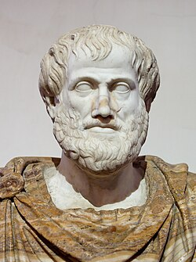
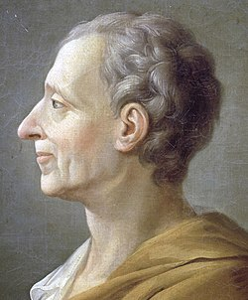
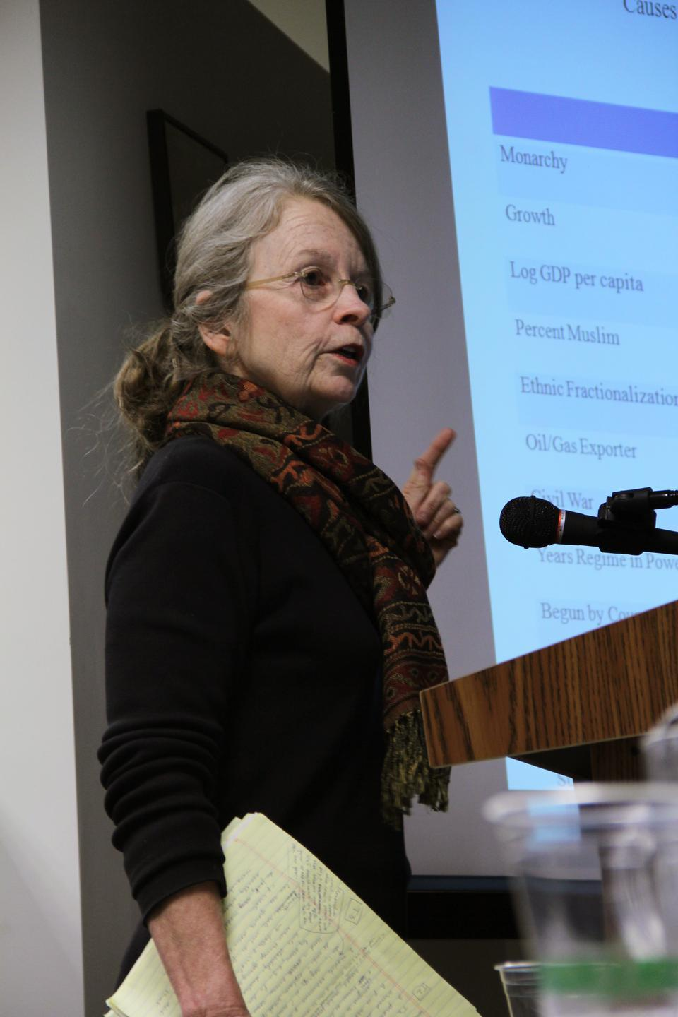
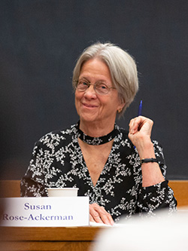
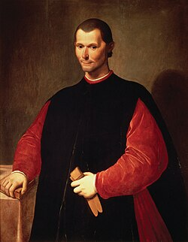
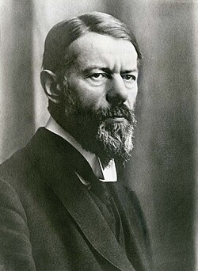
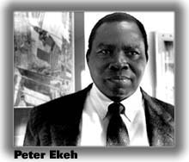
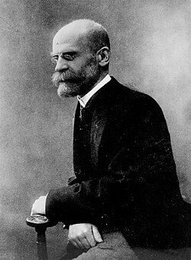
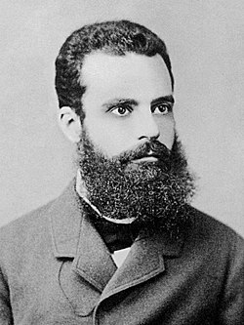

Prelude: Towards a more diverse discipline
Before
More Recently

Slide 3
Schedule
Today: A Brief History of Comparative Politics
Classical Approaches: From Aristotle to Marx
Modernist approaches: From Weber to Easton
Comparative Politics Today
Next Week: Why and How to do Comparative Politics

Slide 4
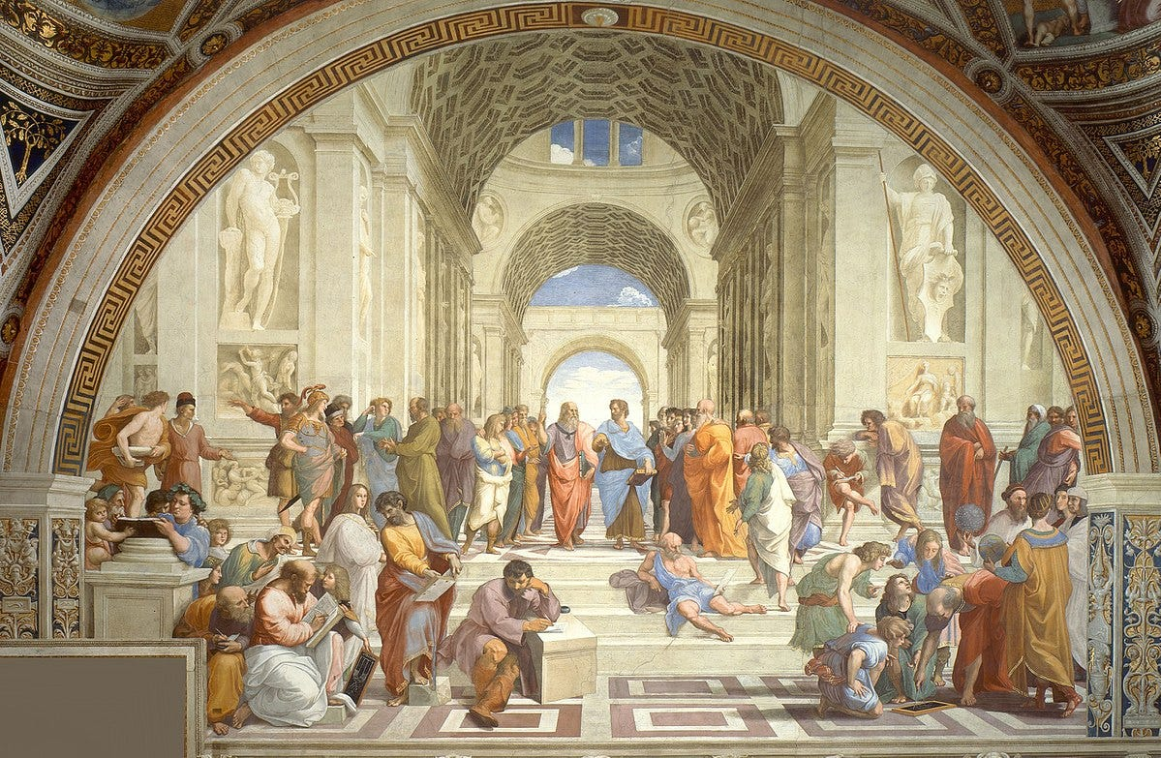
A bit like the Arts...
Classical/Traditional
Raphael's School of Athens (1508-1511)

Slide 5
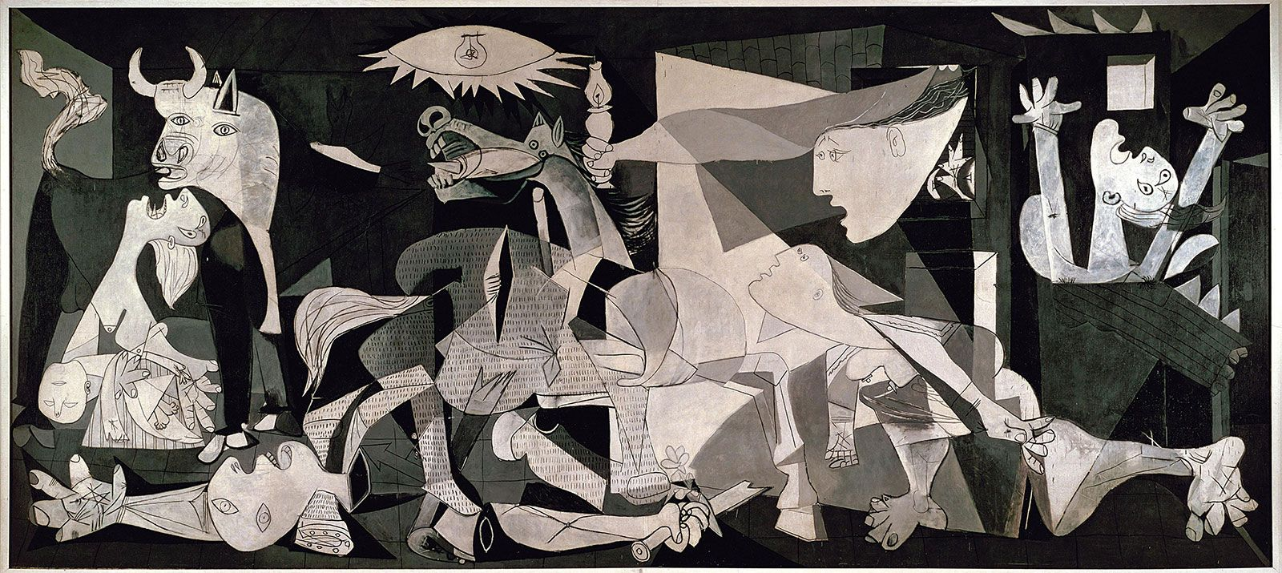
A bit like the Arts...
Modernist
Picasso's Guernica (1937)

Slide 6
… but just the complete opposite
Classical/Traditional
Normative
No rules
Speculative
Unsystematic
Focused on Polities
Method of Agreement
Modernist
Value-Free
Specific rules
Grounded in facts
Systematic
Focused on Politics & Policies
Method of Difference

Slide 7
Aristotle: Comparative Politics before it was cool (4th century BC)
"Nullum magnum ingenium sine mixtura dementiae fuit"
~Seneca the younger, " On Tranquility of Mind" (AD. 60)

Slide 8
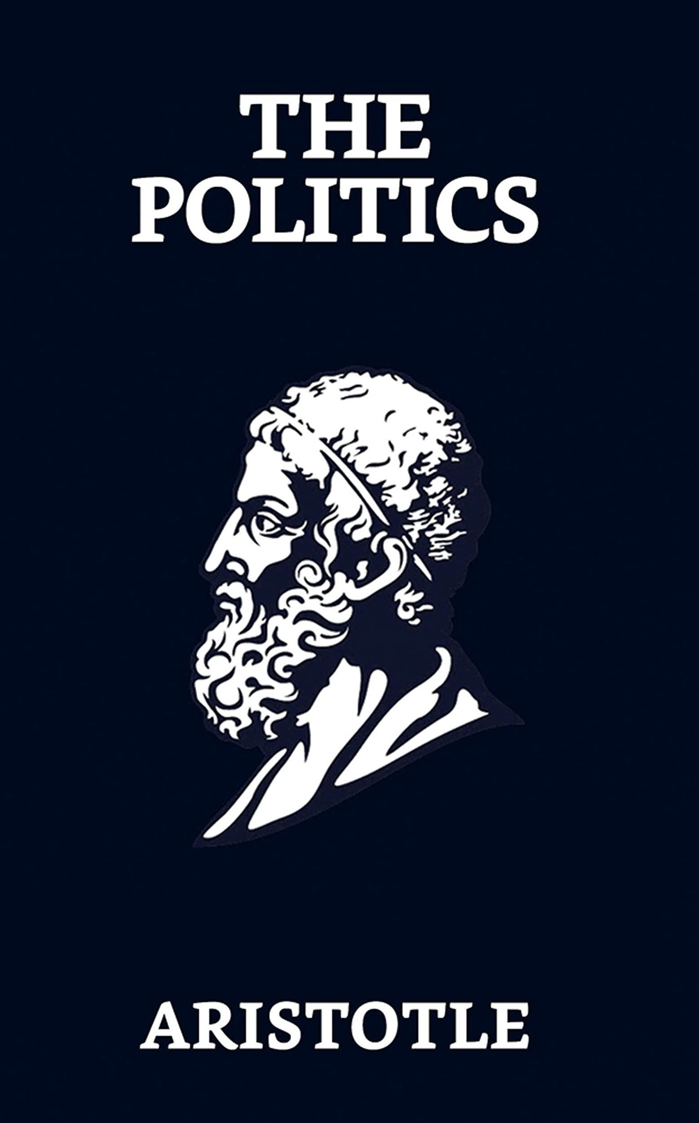
Aristotle: Comparative Politics before it was cool (4th century BC)
The Politics (350 BC)
150 constitutions of Greek city-states
Typology of political systems (#rulers)
#Rulers | Good | Bad/Perverted
1 | Royalty | Tyranny
few | Aristocracy | Oligarchy
many | Polity | Democracy
Normative: "The ideal-state"​
+speculative & ethno-centric

Slide 9
Until Renaissance/Enlightenment: Tyranny of Aristotle's Theory
Then: Historical Comparison
Niccolò Machiavelli (1469-1527)
Montesquieu (1689-1755)​

Slide 10
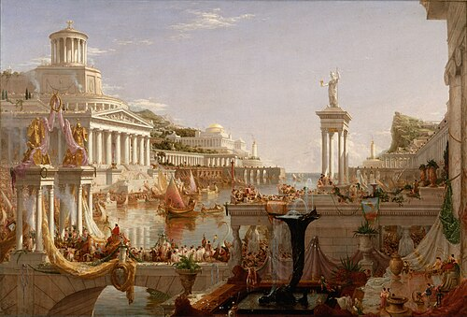
The Course of Empire (Thomas Cole 1833-1836): Consummation

Slide 11
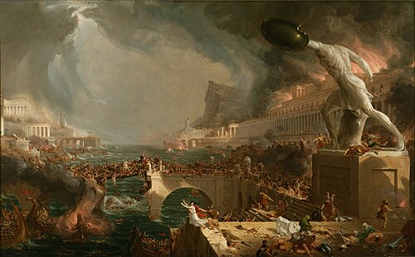
The Course of Empire (Thomas Cole 1833-1836): Destruction

Slide 12
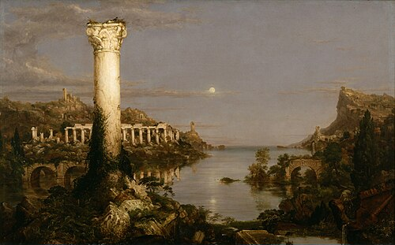
The Course of Empire (Thomas Cole 1833-1836): Desolation

Slide 13
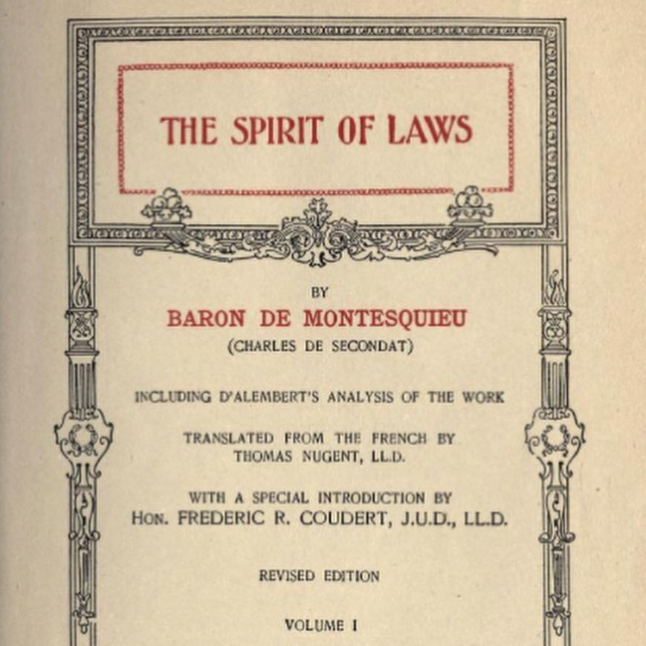
Mo' Concepts & Typologies, Mo' Problems
Regime Downfall: Did not take into account historical differences
Different, inconsistent and normative typologies
f.i. Montesquieu's Spirit of the Laws (1748):
Monarchy
One ruler, fixed laws
Rule
#Rulers
Despotism
One ruler,
fear
Republic
Many rulers,
fixed laws
#Rulers AND Rule

Slide 14
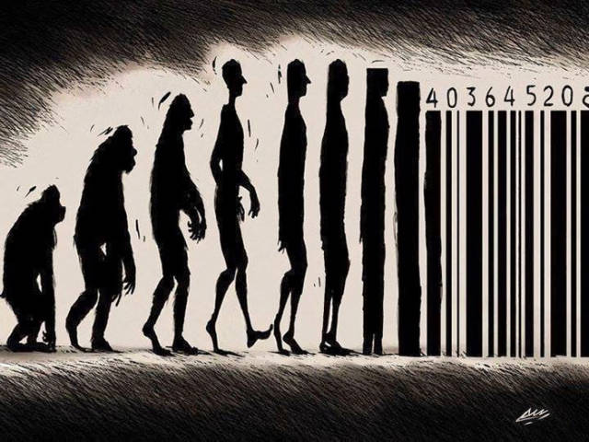
19th century "Modernization": Evolutionist Theories
~ Darwinism
States evolve along a set of stages

Slide 15
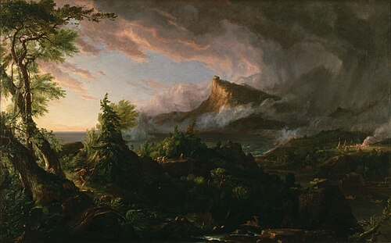
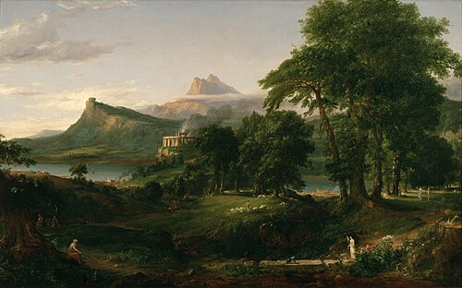
The Course of Empire (Thomas Cole 1833-1836)

Slide 16
The Course of Empire (Thomas Cole 1833-1836)

Slide 17
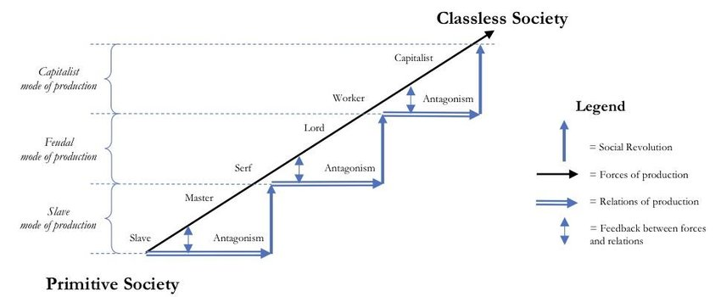
Example: Marx's 5 Stages of Historical Materialism
Capitalist Society
Feudal Society
Ancient Society
Carter, Scott. (2017). Karl Marx and the Marxist School. https://doi.org/10.13140/RG.2.2.27320.03847

Slide 18
19th century "Modernization": Evolutionist Theories
~ Darwinism
States evolve along a set of stages
Mono-causal: One single driver (population, economy, …)
Comparisons remained unsystematic and empirical-anecdotal

Slide 19
The Rise of Classical Modernity: Big 3 & Core 4
Max Weber (1864-1920)
Émile Durkheim (1858-1917)
Vilfredo Pareto
(1848-1923)

Slide 20
The Rise of Classical Modernity: Big 3 & Core 4
Four Core Principles
History =/= Evolution (no final aim, multi-causal)
Theory and Practice are divided (no obligation for political action)
Autonomous subsystems of society (anti-totalitarian)
Value-free, comparative, & theory-guided (and not just typologies)
New Frameworks for Comparative Political Science!

Slide 21
Out with the Old, In with the New:
Behavioralism & Functionalism as Frameworks
19th Century
Old Institutionalism: Constitutions, Laws, Formal Political Processes
1950s-60s
Behavioralism
Focus on explaining political behavior of actors
Voting, turnout, …
Observable

Slide 22
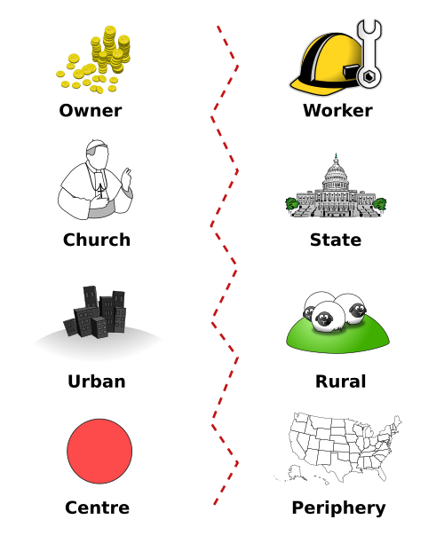
Example: Lipset & Rokkan (1967)
Western-European Cleavages
Cross-national data on party systems X social divisions to explain voting behavior
Socialist & Communist Parties
Owner
Worker
Religious Parties
Church
State
Conservative & Liberal Parties
Agrarian Parties
Industry
Rural
Ethnic / Linguistic Parties
Centre
Periphery

Slide 23
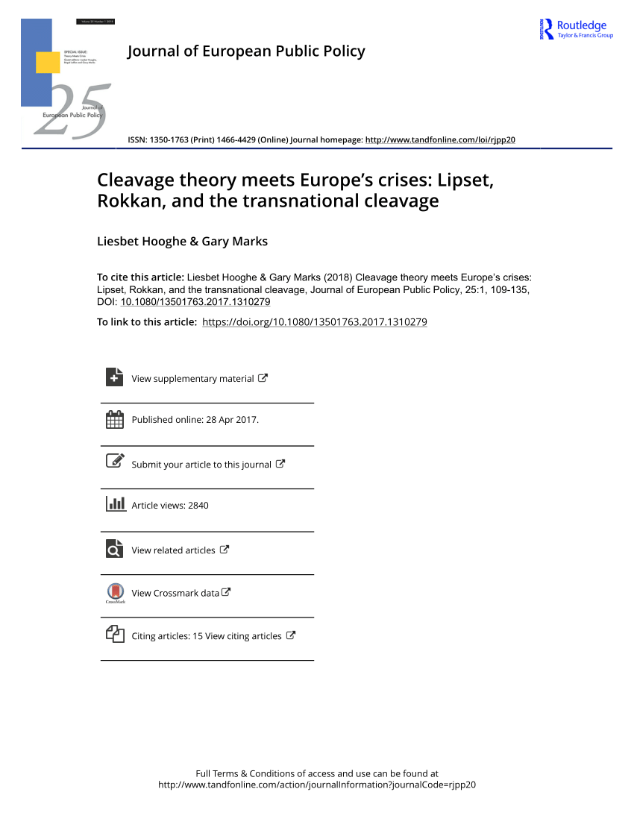

Slide 24
Out with the Old, In with the New:
Behavioralism & Functionalism as Frameworks
19th Century
Old Institutionalism: Constitutions, Laws, Formal Political Processes
1950s-60s
Behavioralism
Focus on explaining political behavior of actors
Voting, Turnout, …
Observable
Functionalism
Good Functioning of Political System
Structures
Abstract

Slide 25
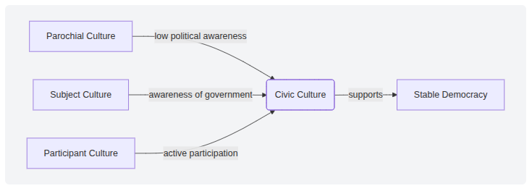
Example: Almond & Verba (1967)
The Civic Culture
What makes a stable and successful democracy?
Cross-national data on attitudes & political behavior

Slide 26
Synthesis: Easton's Framework for Political Analysis (1965)
Behavioralism (lack of theory) + Functionalism (surplus of theory): new major tenets for the discipline
Observed regularities > general statements/theories
Validity of these must be tested & can be verified
Importance of data collection & interpretation, particularly quantification & measurement
Separation of ethics (normative) from scientific explanation
Still relevant today!

Slide 27

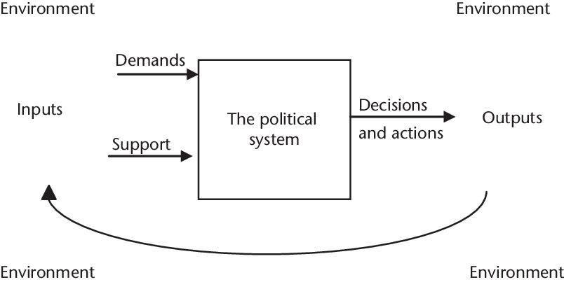
The Final Step: Policies
Input-Output: Easton's Model of a Political System
(50s-60s)
Black Box
Policies
Feedback

Slide 28
The Final Step: Policies
Within-put: Heidenheimer-Heclo School (1975)
Within-Put
Policies
Parties, interest groups, admin, ...
Feedback

Slide 29
Comparative Politics Today
New Institutionalism: institutions shape and are shaped by political behavior
Methodological variety: Quantitative, Large-N vs qualitative case studies & Mixed Methods
More inclusive, less Western-centric: feminist theory, postcolonialism etc.
Transnational!

Slide 30
Main Takeaways
Classical Approaches were unstructured, normative, and focused on similarities between polities
Modernist approaches were more structured, empirical, and focused on differences between politics and policies
Today, the discipline of comparative politics is broad, inclusive, and transnational
But why is it relevant today? And how do we do it?

Slide 31
See you next week!

